Slide 1


Who Wants to
Be a Millionaire?
Notes:
Lifeline icons on the question slides are hyperlinks which will take you to the lifeline screen. To return to the game, you may right click on the screen, choose Go, Previously Viewed. This should return you to the question slide. Alternatively, left click as usual to return to the game board, then click on the highest number that has been previously selected (in gold to indicate a followed hyperlink).
To utilize the 50:50 option, the moderator may tell the contestant which two options to disregard or, use Control-P to change the mouse arrow to a pen. Draw a line through two incorrect responses, then use Control-A to change the pen back into an arrow and continue with the game.
Clicking on the action button on the phone handset image of the Phone a Friend lifeline slide will hyperlink to the Ask Jeeves web site where the participant may ask for help.

Slide 2



1,000,000
500,000
250,000
125,000
64,000
32,000
16,000
8,000
4,000
2,000
1,000
500
300
200
100

Slide 3


Click to return to question, Cont-P to switch to the pen, cross out two incorrect answers, then Cont-A to switch back to pointer.

Slide 4

Click to return to the question and poll the class

Slide 5
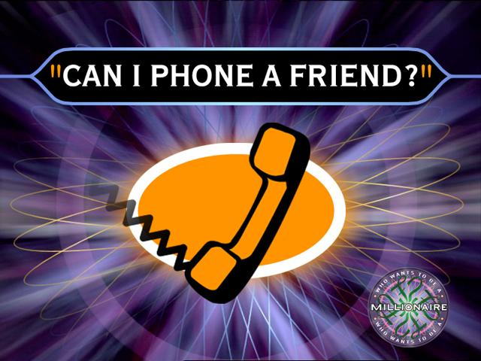
Click on link to Ask Jeeves, or click on this oval to return to question and ask a friend

Slide 6
Where is the BMX track in Taupo?
A. Crown Park
B. Right st
C. Tab ave
D. Kingsway rd

Slide 7
A. Good Job!
Back to Board

Slide 8
What street do we live on?
A. Logan ave
B. Park rd
C. Stanley st
D. Water st

Slide 9
C. Good Job!
Back to Board

Slide 10
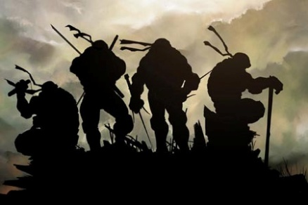
Who is this ?
A. Kiwis
B. Teenage Mutant Ninja Turtles
C. Pokémon
D. Cat

Slide 11
B. Good job!
Back to Board

Slide 12
What sport do we like ?
A. Rugby
B. Tennis
C. Hockey
D. Soccer

Slide 13
A. Good Job!
Back to Board

Slide 14
What book dose Logan like ?
A. The little duck
B. Survival
C. Monster blood 2
D. Zac power

Slide 15
D. Good Job!
Back to Board

Slide 16
Where did Johan live in South Africa
A. Zambia
B. Kingsway
C. Durban
D. Burma

Slide 17
C. Good Job!
Back to Board

Slide 18
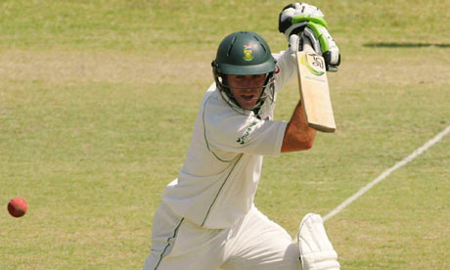
Who is this ?
A. Ab Morkil
B. Ab de Villies
C. John smith
D. Johann milire

Slide 19
B. Good Job!
Back to Board

Slide 20
What’s our fav Pokémon ?
A. Giratana
B. Milktank
C. Pikachu
D. Viper

Slide 21
C. Good Job!
Back to Board

Slide 22
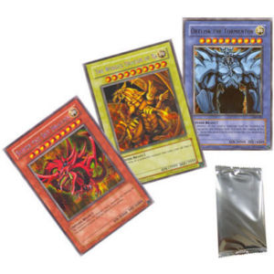
Who is this?
A. Dark magishin
B. Oblis
C. Titnik
D. 3 god cards

Slide 23
D. Good Job!
Back to Board

Slide 24
What music band dose Johan like?
A. slipnot
B. green day
C. nikilis low
D. wislive

Slide 25
B. Good Gob
Back to Board

Slide 26
Who is Logan’s fav BMX rider ?
A. Kurt Pickard
B. Sarah Walker
C. Marc Willers
D. Mike Day

Slide 27
A. Good Job!
Back to Board

Slide 28
What number is on Logan’s letter box ?
A. 22
B. 56
C. 101
D. 42

Slide 29
B. Good Job!
Back to Board

Slide 30
What is Johan's letter box number
A. 111
B. 48
C. 56 b
D. 23

Slide 31
C. Good Job!
Back to Board

Slide 32
What’s Johan’s fav colour
A. Blue
B. Purple
C. Black
D. Green

Slide 33
D. Good Job!
Back to Board

Slide 34

What BMX brand is this
A. Answer
B. FLY
C. THOR
D. Red bull

Slide 35
A. Good Job!

Slide 36
Sorry, try again!

Slide 37
Thanks for playing!

